Slide 1
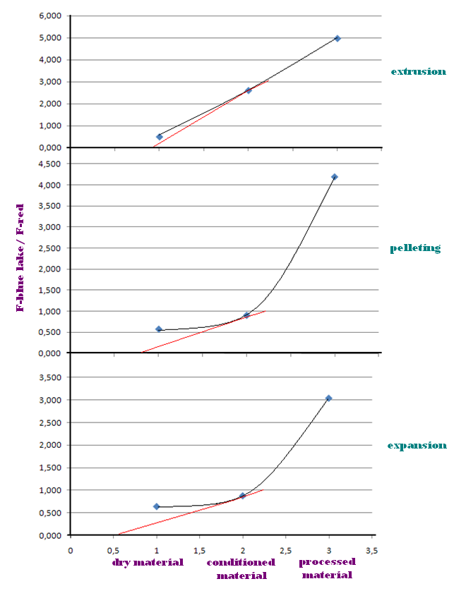
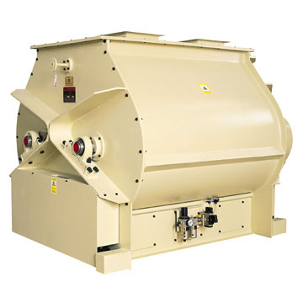
THE 14 TH INTERNATIONAL SCIENTIFIC SYMPOSIUM ON FEED TECHNOLOGY, QUALITY AND SAFETY
NOVI SAD, OCTOBER,19-21, 2010.
STABILITY OF MICROTRACER® IN THERMAL FEED PROCESSING
Dušica Ivanov¹, Radmilo Čolović¹, Bojana Kokić¹, Đuro Vukmirović¹, Jovanka Lević¹, Olivera Đuragić¹, Slavica Sredanović¹
¹Institute for Food Technology, University of Novi Sad, Bul. cara Lazara 1, 21000 Novi Sad, Serbia
Introduction
Results and Disscusion
External markers - indigestible compounds added to the diets, for example, polyethylene, metallic iron powder or celite, a form of diatomaceous silica, can be used in that purpose
Marking feed for recognizing it on market - IMPORTANT ROLE
Microtracers® San Francisco – harmless, rapid analysis with simple equipment
Slope of curve after conditioning have been the highest in pelleting process, becouse of longer period of contact between tracers and moistened material.
Lines of graphs that have represented F‑blue lake and F-red tracers have had almost the same trend between points of expansion and pelleting, due to the fact that moisture content of 16.20% and 17.26% caused very similar mechanism of water effect on tracers’ color.
Objectives of The Experiment
Determination of stability of microtracer markers (diferent types) depending on temperature and moisture content in order to determine initial concentration tracers
Evaluation of microtracers usage for tagging feed after processing, such as pelleting, extrusion and expansion
Comparation of its effectiveness in mentioned processes
Material and Methods
Reduction of tracers’ particle number after conditioning for different processes
Feed mash for cattle - treated with hot steam in the double shaft paddle mixer-conditioner
 |  | expansion | pelleting | extrusion
Moisture content of conditioned material [%] |  | 16.2 | 17.26 | 23.22
F – blue lake tracer | Average number of particles before conditioning | 16.2 | 17.26 | 23.22
 | Average number of particles after conditioning | 68.51 | 74.79 | 82.37
 | Reduction of number of particles after conditioning [%] | 64.05 | 61.36 | 67.19
F – red tracer | Average number of particles before conditioning | 6.504 | 17.96 | 18.43
 | Average number of particles after conditioning | 110.29 | 132.33 | 165.56
 | Reduction of number of particles after conditioning [%] | 72.50 | 67.54 | 25.81
Three different ways of processing – pelleting, extrusion, expansion
Adding of two different tracers - F–blue lake, F-red
Granules formed by pelleting, expansion and extrusion processes - grinded before separation of tracers on laboratory disc mill, GlenMills Inc
Analyzing of separated tracers – magnetic separator “Rotary detector”
Developing of tracers’ colors - 7% solution of Na₂CO₃
Number of particles counted
Double shaft paddle mixer-conditioner, Muyang Group, China
Conditioning of material caused reduction of number of both tracers’ particle.
Higher moisture content lead to higher values of F-blue lake/F-red ratio.
In all experiments, it could not be noticed any dependence between tracers’ particle number and temperature of processed material.
F-blue lake tracer was more stabile, than F-red tracer and can be used for marking processed feed.
Authors are suggesting following amounts of F-blue lake tracer: for pelleting and extrusion about 20% more, and for expansion about 7% more than initial concentrations.
Conclusions

